Slide 1
CHANDIDAS MAHAVIDYALAYA
DEPARTMEANT OF GEOGRAPHY
Topic.- Urban Site & situation
Prof.- Indrajit Mandal

Slide 2
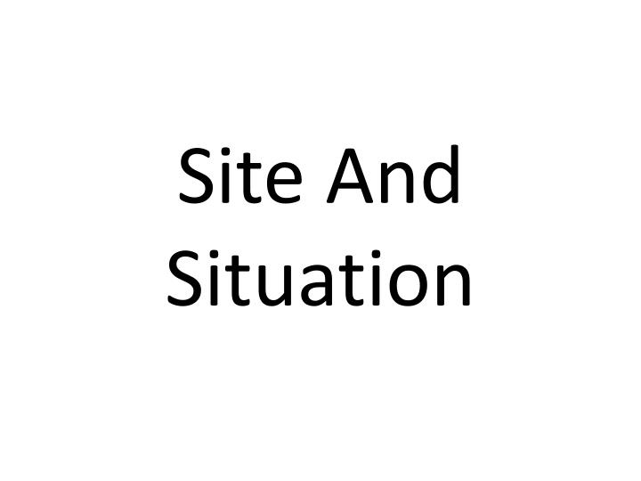

Slide 15
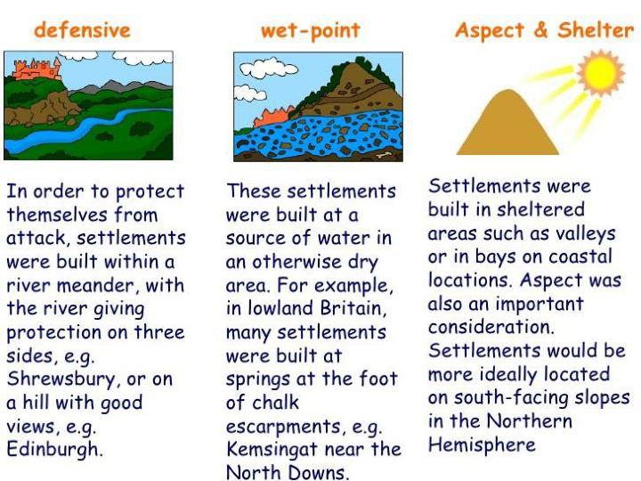

Slide 40
Thank you

